Slide 1

The parts business is growing. The channel is still leaking.
UMI / FY2027 target discussion · Bloomberg Businessweek-style prototype
YTD vs budget
Commercial parts
+2%
+34%
€875k vs €855k
CY H1 2026 vs 2025
But July is the warning
-38% YoY
Shell price hold is the stated gap into August
ISZE / UMI Sales Review Prototype
source: UMI Sales Review FY2027
Notes:
[Sources]
- Source deck: ISZE_UMI_Sales_Review_FY2027_ModeA_only.pptx. UMI review title and meeting context: lines 23-25.
- FY2027 YTD and budget/LY figures: lines 55-65.
- Commercial parts performance: lines 70-80.
- Category movers: lines 85-150.
- GPS, service-parts coverage, IDS and fleet/target data: lines 176-235 and 240-276.
- SPA and Sales-to-Dealer ask: lines 286-345.

Slide 2
The headline number hides a split market
Commercial parts are up; routine service categories still point to leakage.
ISZE / UMI Sales Review Prototype
source: UMI Sales Review FY2027
Notes:
[Sources]
- Source deck: ISZE_UMI_Sales_Review_FY2027_ModeA_only.pptx. UMI review title and meeting context: lines 23-25.
- FY2027 YTD and budget/LY figures: lines 55-65.
- Commercial parts performance: lines 70-80.
- Category movers: lines 85-150.
- GPS, service-parts coverage, IDS and fleet/target data: lines 176-235 and 240-276.
- SPA and Sales-to-Dealer ask: lines 286-345.

Slide 3
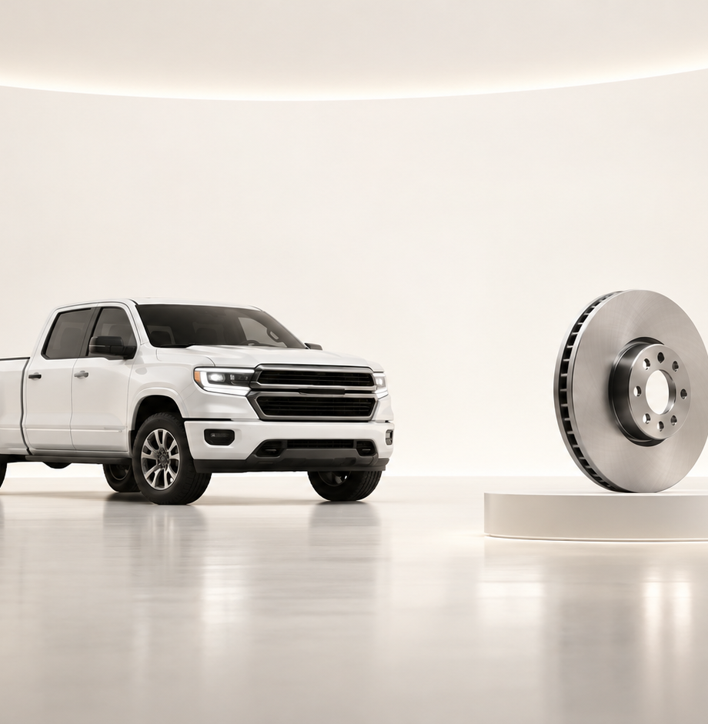
The easiest story to sell is the service-parts gap
Brake rotor and air filter are the clearest places to start a joint pilot.
GPS capture
IDS average
54.2%
60.9%
€4.636m fleet potential on 18,542 vehicles
13.9 points below network
Brake rotor
12%
Air filter
22.9%
ISZE / UMI Sales Review Prototype
source: UMI Sales Review FY2027
Notes:
[Sources]
- Source deck: ISZE_UMI_Sales_Review_FY2027_ModeA_only.pptx. UMI review title and meeting context: lines 23-25.
- FY2027 YTD and budget/LY figures: lines 55-65.
- Commercial parts performance: lines 70-80.
- Category movers: lines 85-150.
- GPS, service-parts coverage, IDS and fleet/target data: lines 176-235 and 240-276.
- SPA and Sales-to-Dealer ask: lines 286-345.

Slide 4
Make the meeting about four choices — not 18 slides
The customer should leave knowing exactly what has to be decided.
Four choices
FY2027 extended target
Close Shell price hold
€3.05m
BP + 1.8% stretch
Pick first service-parts pilot
Return SPA counter-list
Fleet estimate
-7.4%
Share Sales-to-Dealer data
2025 → 2026 working estimate
Data ask
Part-level monthly
Sales-to-Dealer from 01/01/2025
ISZE / UMI Sales Review Prototype
source: UMI Sales Review FY2027
Notes:
[Sources]
- Source deck: ISZE_UMI_Sales_Review_FY2027_ModeA_only.pptx. UMI review title and meeting context: lines 23-25.
- FY2027 YTD and budget/LY figures: lines 55-65.
- Commercial parts performance: lines 70-80.
- Category movers: lines 85-150.
- GPS, service-parts coverage, IDS and fleet/target data: lines 176-235 and 240-276.
- SPA and Sales-to-Dealer ask: lines 286-345.

